Slide 1
NYCU 2021 Spring DLP Lab7: Let's Play GANs with Flows and friends
TA 陳鵬宇
May 25, 2021

Slide 2
Outline
Important Dates
Lab Description
Implementation Details
Scoring Criteria

Slide 3
Important Dates
Report submission deadline: June 15 (Tue.), 11:59 a.m.
No demo
Submission format: DLP_LAB7_yourstudentID_name.zip
Report (.pdf)
Source codes (.py)
Example: DLP_LAB7_309551113_陳鵬宇.zip
-5% score penalty if your format is wrong

Slide 4
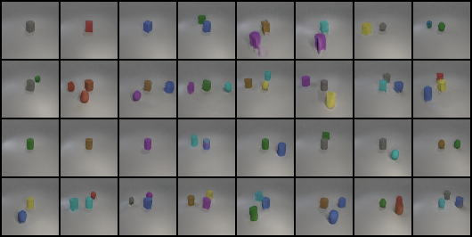
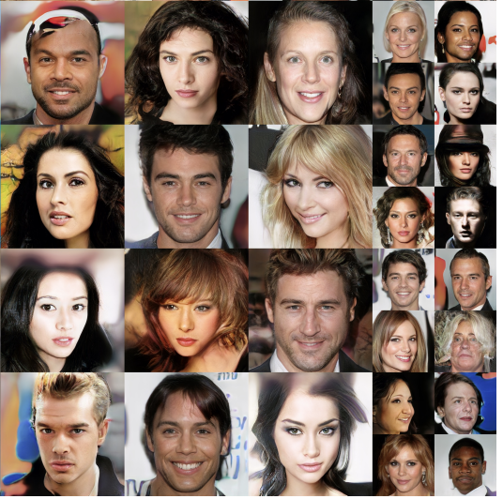
Lab Description
Implement conditional GAN & Normalizing Flow
2 Tasks:
Object Image Generation
Human Face Generation
Source: Karras et al.

Slide 5
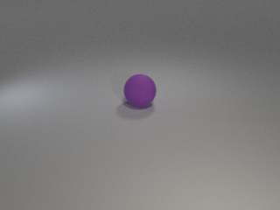
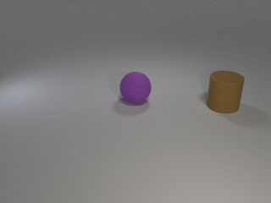
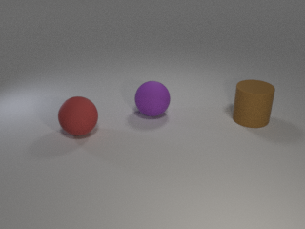
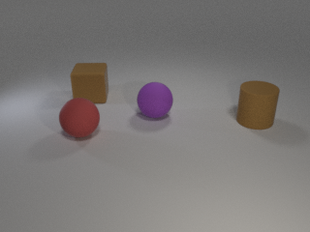
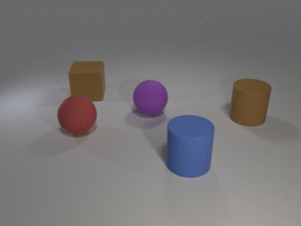
Lab Description – Task 1
Object Image Generation – iCLEVR dataset
Dataset overview:
Multiple objects in 1 images
24 classes: cyan cylinder, red cube, green sphere…
Same object will not appear twice in an image

Slide 6
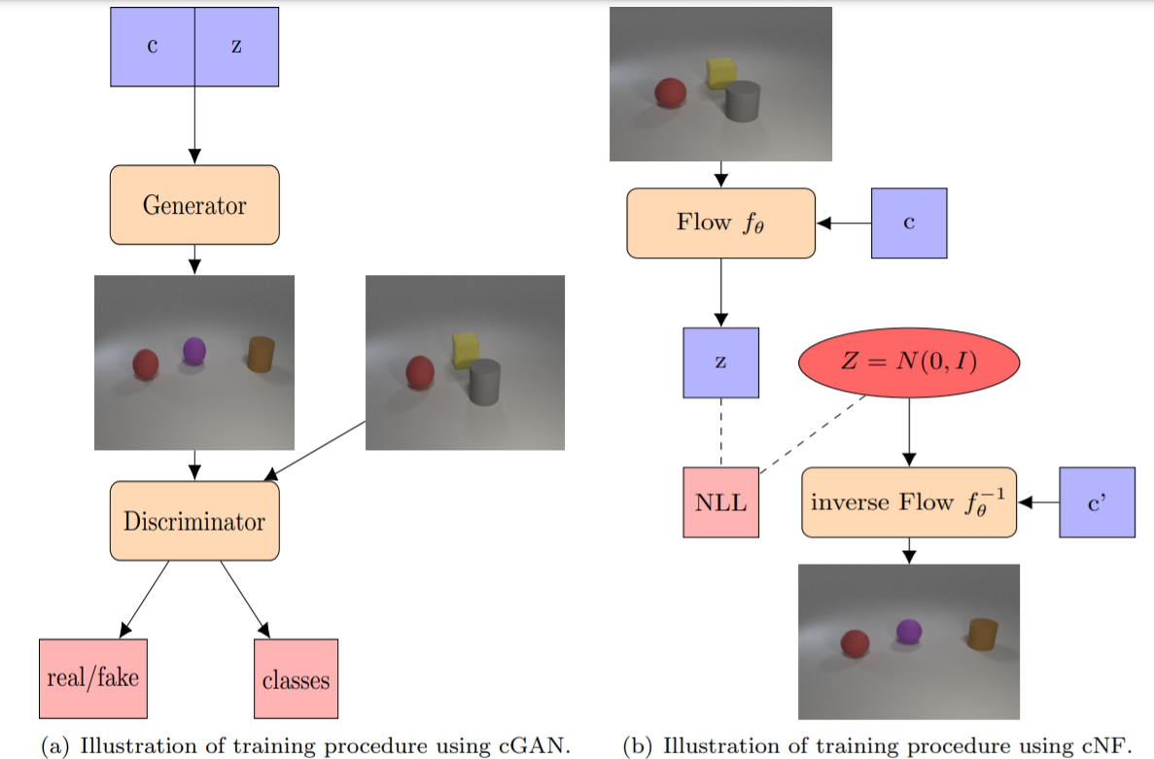
Lab Description – Task 1
You need to:
Implement a conditional GAN
Implement a conditional NF model
Use a pretrained classifier to evaluate accuracy

Slide 7
Implementation Details – Task 1
We provide some network architectures in lab spec
You can totally ignore suggested methods & use whatever you like
You cannot use other training data except for the provided files (for example: background images)

Slide 8
Implementation Details – Task 1
We provided a pre-trained ResNet-18 & evaluation model. You need to use eval(images, labels) to compute accuracy of your synthetic images
The resolution of input for pretrained classifier is 64x64. You can design your own output resolution for generator and resize it.

Slide 9
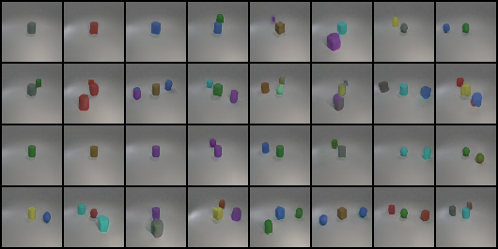
Implementation Details – Task 1
Output examples:
Accuracy: 0.667
Accuracy: 0.847

Slide 10
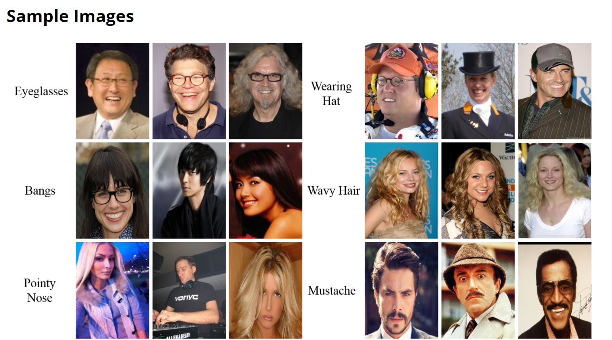
Lab Description – Task 2
Human Face Generation – CelebA-HQ dataset
Dataset overview:
30000 faces of celebrities with multiple attributes
40 attributes: Bangs, Blond_Hair, Eyeglasses, Mustache, Smiling…
Source: CelebA

Slide 11
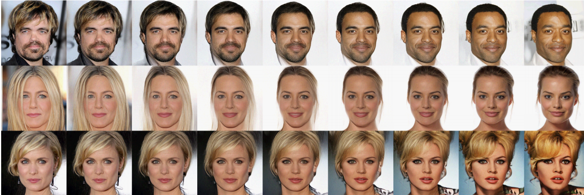
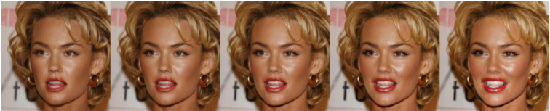
Lab Description – Task 2
You need to:
Implement a (conditional) NF model
Accomplish several applications:
Conditional face generation: Generate faces given attributes as conditions
Linear interpolation
Attribute manipulation: “Smiling”

Slide 12
Implementation Details – Task 2
Similarly, we list some suggested architecture for you, and you can adopt any other method you prefer
You can finish 2nd & 3rd task without conditioning
It’s suggested that you try resolution of 64x64 first

Slide 13
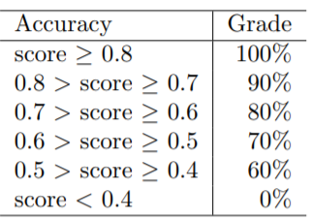
Scoring Criteria
Report
Introduction (10%)
Implementation details (15%)
Task 1 (45%)
Result (generated images) (5%)
Classification accuracy on test.json and new_test.json using cGAN and cNF. (5% on test.json, 10% on new_test.json for each model)
Discussion (10%)
Task 2 (30%)
Conditional face generation: At least 4 images with at least 3 conditions
Linear interpolation: 3 pairs of images with at least 5-image interpolations
Attribute manipulation: At least 2 attributes of same image

Slide 14
Have Fun~

